Slide 1
Gram-Schmidt orthogonality process

Slide 2
Recall: Dot Product (inner product)
Think of the dot product as a matrix multiplication
1 X N
N X 1
1 X 1
MATLAB: ‘inner matrix dimensions must agree’
Outer dimensions give
size of resulting matrix

Slide 3



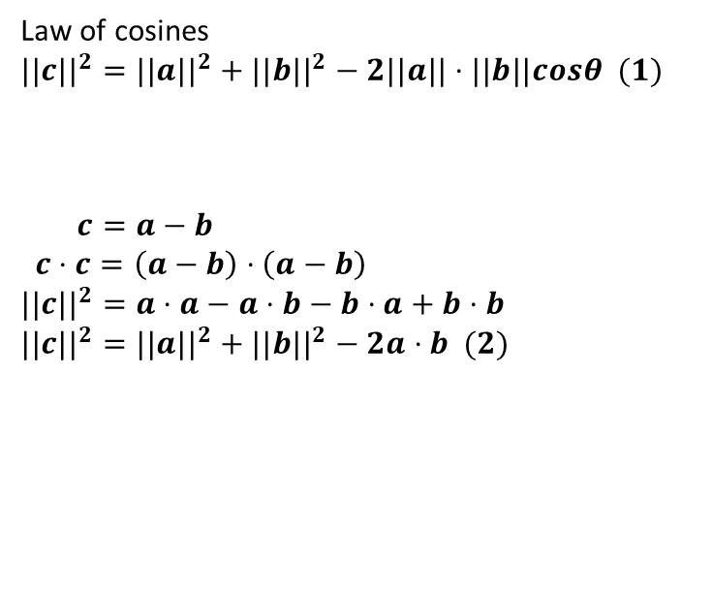
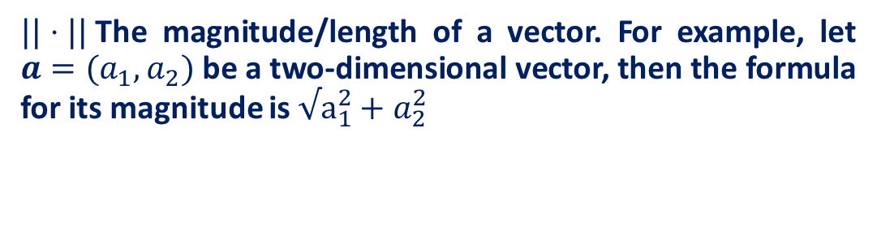





Recall: Dot Product (inner product)
$$a$$
$$\vec{a}$$
$$c$$
The dot product is also related to the angle between the two vectors
$$\vec{c}$$
$$a⋅b =||a|| ||b||cos θ$$
$$θ$$
$$\vec{b}$$
$$b$$
Law of cosines
$$||c||^{2}=||a||^{2}+||b||^{2}−2||a||⋅||b||cosθ (1)$$
$$c=a−b$$
$c⋅c=\left(a−b\right)⋅\left(a−b\right)$
$$||c||^{2}=a⋅a−a⋅b−b⋅a+b⋅b$$
$$||c||^{2}=||a||^{2}+||b||^{2}−2a⋅b (2)$$
$||⋅||$The magnitude/length of a vector. For example, let $a=(a_{1},a_{2})$ be a two-dimensional vector, then the formula for its magnitude is$√a_{1}^{2}+a_{2}^{2}$

Slide 4

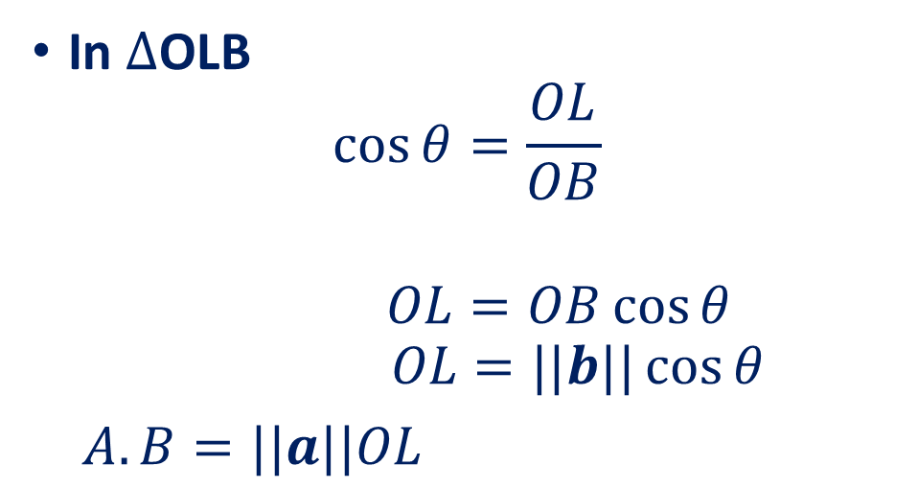









Recall: Dot Product Geometrical Interpretation
The dot product is also related to the angle between the two vectors
$$a⋅b =||a|| ||b||cos θ$$
In $∆$OLB
$$\cos{θ}=\frac{OL}{OB}$$
$$OL=OB\cos{θ}$$
$$OL=||b||\cos{θ}$$
$A.B=||a||OL$
$$B$$
$$\vec{b}$$
$$θ$$
$$\vec{a}$$
$$O$$
$$\vec{b}\cos{θ}$$
$$A$$
$$L$$
Magnitude of vector A
Projection of vector B on A
$$A.B=0 ⟹A⊥B$$

Slide 5
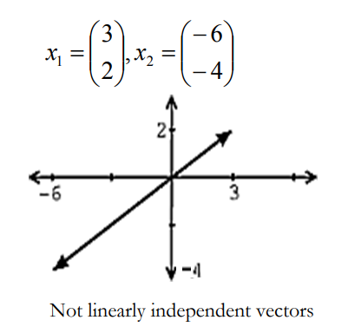
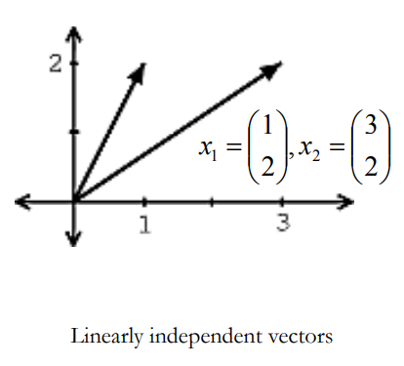
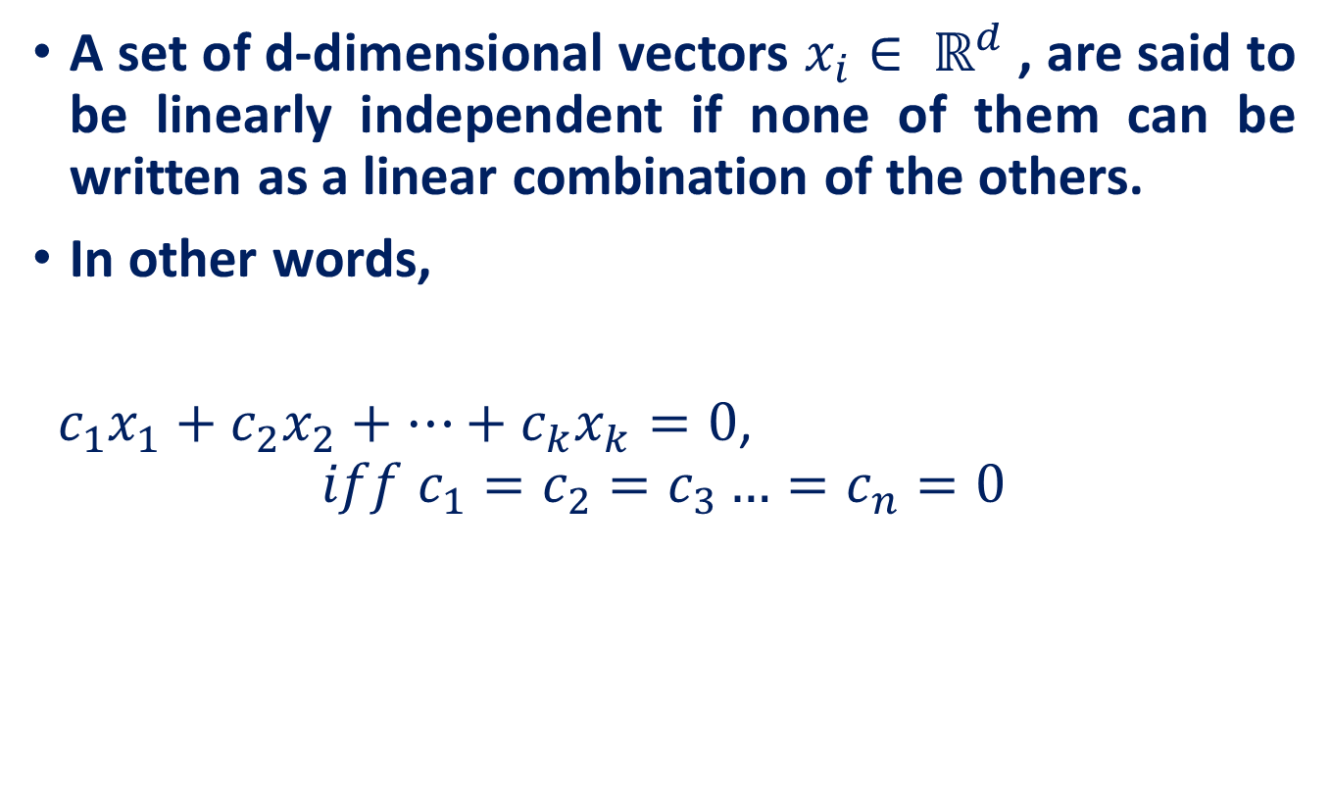
Recall: Linear Independence
A set of d-dimensional vectors $x_{i}∈ ℝ^{d}$, are said to be linearly independent if none of them can be written as a linear combination of the others.
In other words,
$c_{1}x_{1}+c_{2}x_{2}+…+c_{k}x_{k}=0$,
$$iff c_{1}=c_{2}=c_{3}…=c_{n}=0$$

Slide 6

Recall: Span
A span of a set of vectors $x_{1}, x_{2}, … , x_{k}$is the set of vectors that can be written as a linear combination of $x_{1}, x_{2}, … , x_{k}$.
$$span\left(x_{1}, x_{2},…, x_{k}\right)= \left\{c_{1}x_{1}+ c_{2}x_{2}+…+ c_{k}x_{k} \right|c_{1},c_{2},…,c_{k}∈ℝ\}$$

Slide 7
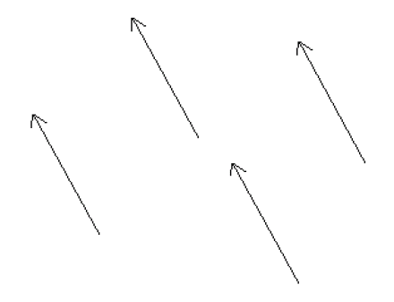
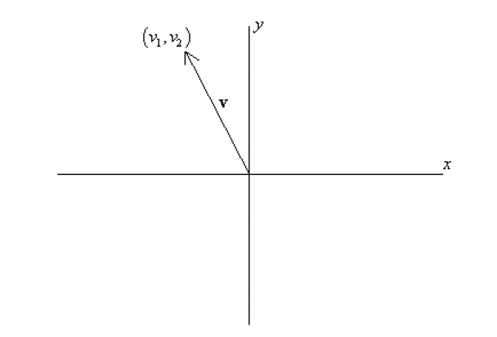
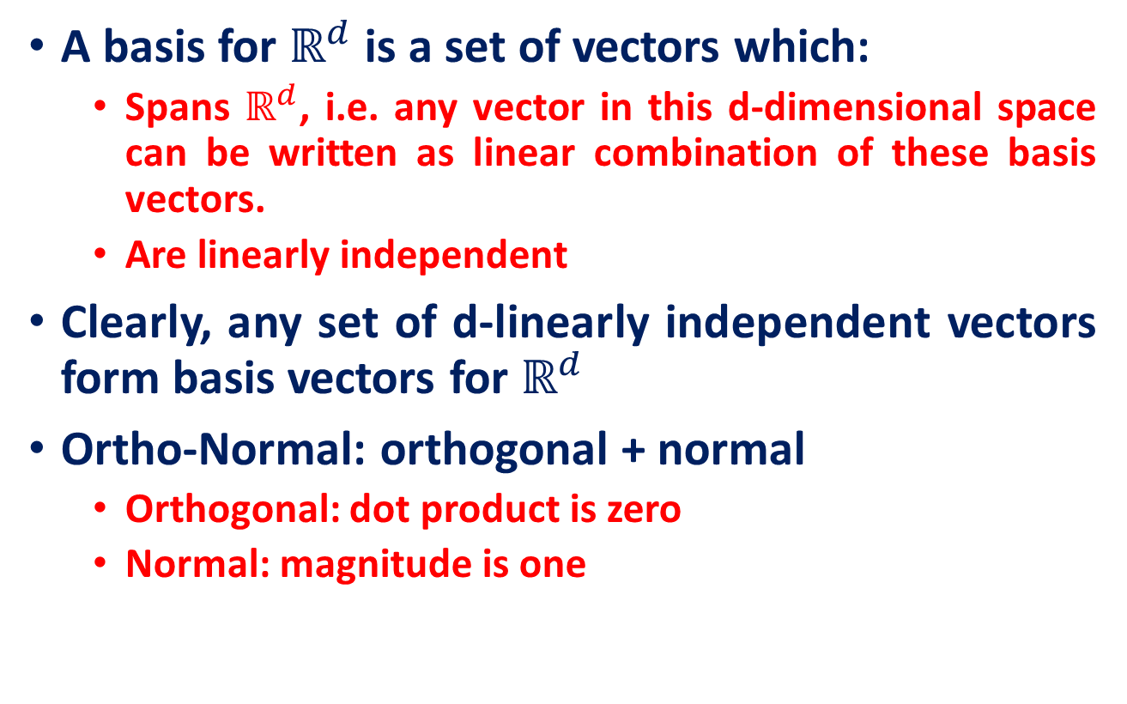


Recall: Bases & Orthonormal Bases
A basis for $ℝ^{d}$ is a set of vectors which:
Spans $ℝ^{d}$, i.e. any vector in this d-dimensional space can be written as linear combination of these basis vectors.
Are linearly independent
Clearly, any set of d-linearly independent vectors form basis vectors for $ℝ^{d}$
Ortho-Normal: orthogonal + normal
Orthogonal: dot product is zero
Normal: magnitude is one
vs
$$x={\left[\begin{matrix}1 & 0 & 0\end{matrix}\right]}^{T} \\ y={\left[\begin{matrix}0 & 1 & 0\end{matrix}\right]}^{T} \\ z={\left[\begin{matrix}0 & 0 & 1\end{matrix}\right]}^{T}$$
$$x⋅y=0 \\ x⋅z=0 \\ y⋅z=0$$

Slide 8
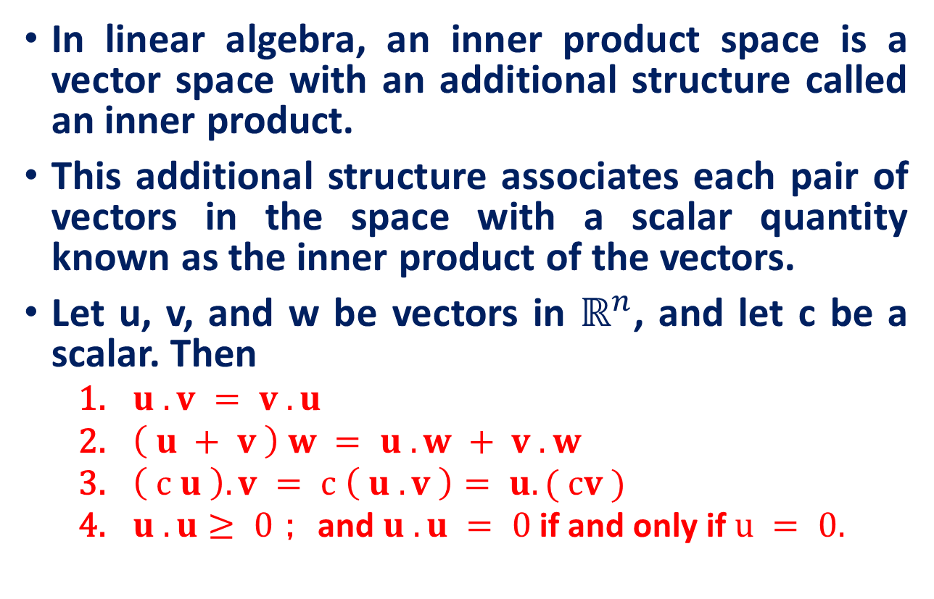
Inner product space
In linear algebra, an inner product space is a vector space with an additional structure called an inner product.
This additional structure associates each pair of vectors in the space with a scalar quantity known as the inner product of the vectors.
Let u, v, and w be vectors in $ℝ^{n}$, and let c be a scalar. Then
$u . v = v . u$
$\left( u + v \right) w = u . w + v . w$
$\left( c u \right).v = c \left( u . v \right)= u.( cv )$
$u . u≥ 0$； and $u . u = 0$if and only if $u = 0.$

Slide 9
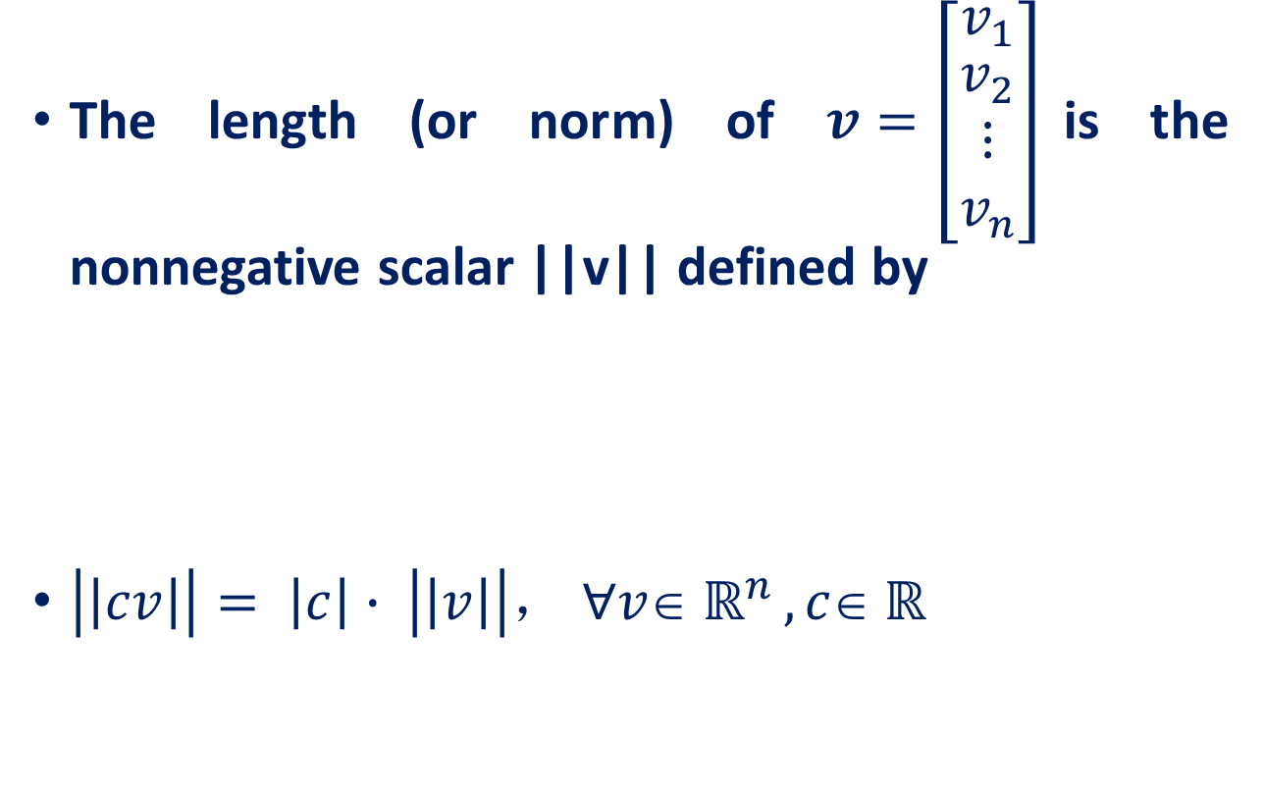
The Length of Vector
The length (or norm) of $v=\left[\begin{matrix}v_{1} \\ \begin{aligned}v_{2} \\ ⋮ \\ v_{n}\end{aligned}\end{matrix}\right]$is the nonnegative scalar ||v|| defined by
$\left|\left|cv\right|\right|= \left|c\right|∙ \left|\left|v\right|\right|， ∀v∈ ℝ^{n} , c∈ ℝ$

Slide 10
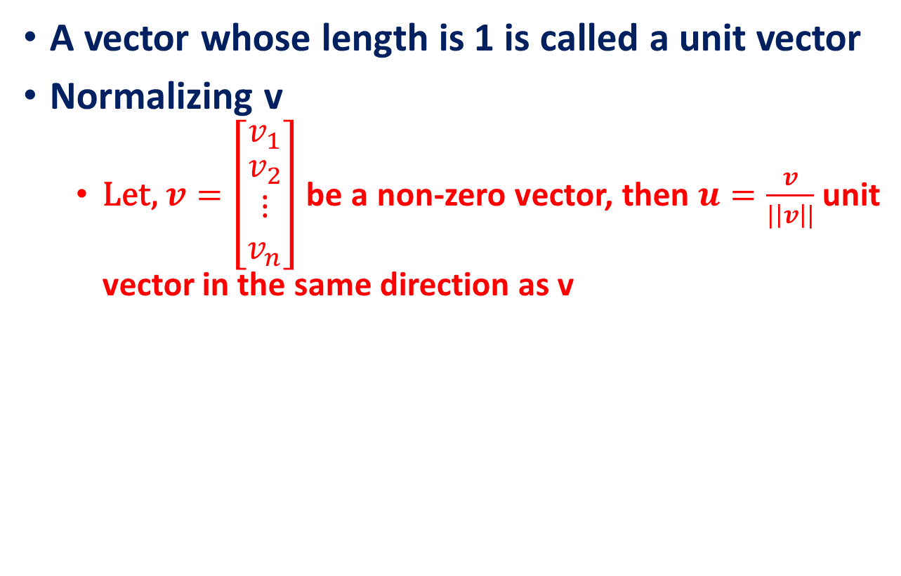
Normalizing v
A vector whose length is 1 is called a unit vector
Normalizing v
Let, $v=\left[\begin{matrix}v_{1} \\ \begin{aligned}v_{2} \\ ⋮ \\ v_{n}\end{aligned}\end{matrix}\right]$ be a non-zero vector, then $u=\frac{v}{|\left|v\right||}$ unit vector in the same direction as v

Slide 11

Distance between two vectors
For u and v in $ℝ^{n}$, the distance between u and v, written as dist(u, v), is the length of the vector $u – v$. That is,
$$\text{dist}\text{(}\text{u}\text{, }\text{v}\text{)}\text{=||}\text{u}\text{−}\text{v}\text{||}$$

Slide 12
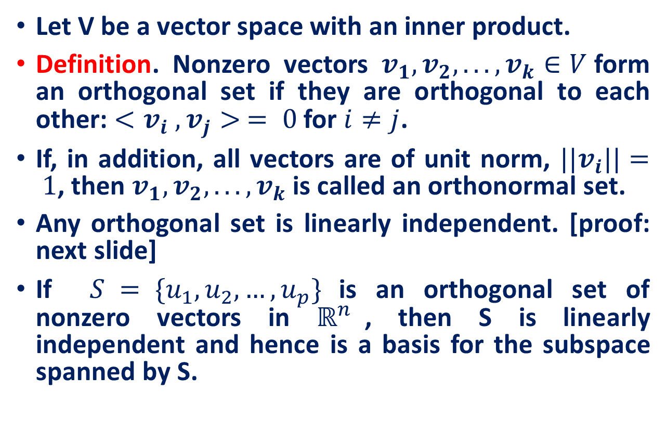
Orthogonal sets
Let V be a vector space with an inner product.
Definition. Nonzero vectors $v_{1}, v_{2}, . . . , v_{k}∈V$form an orthogonal set if they are orthogonal to each other: $<v_{i} , v_{j}> = 0$for $i≠j$.
If, in addition, all vectors are of unit norm, $||v_{i}||= 1$, then $v_{1}, v_{2}, . . . , v_{k}$is called an orthonormal set.
Any orthogonal set is linearly independent. [proof: next slide]
If $S = \{u_{1}, u_{2}, …, u_{p}\}$is an orthogonal set of nonzero vectors in $ℝ^{n}$, then S is linearly independent and hence is a basis for the subspace spanned by S.

Slide 13
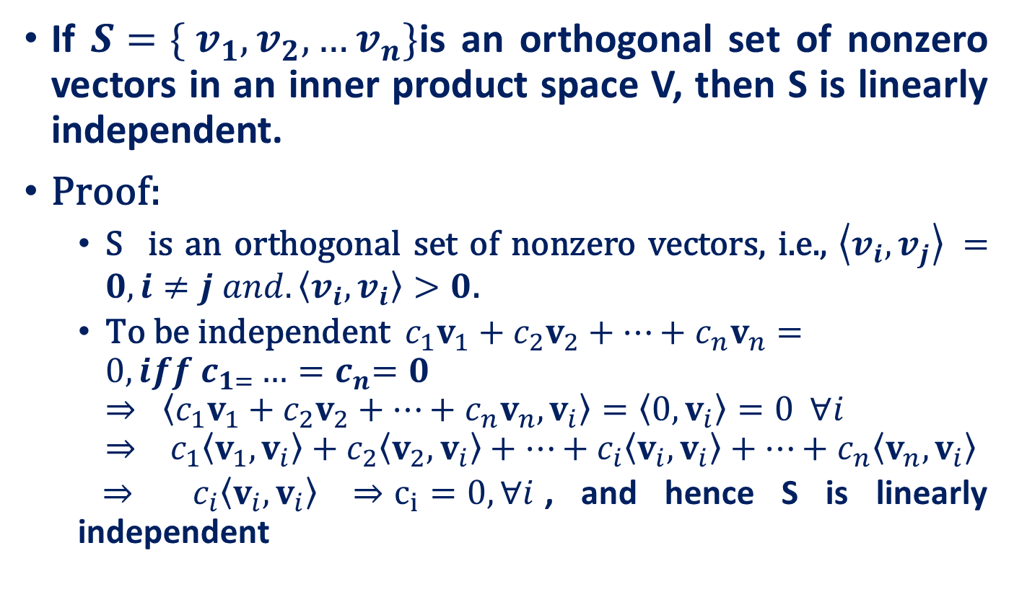
Orthogonal sets are linearly independent
If $S=\{ v_{1},v_{2}, …v_{n}\}$is an orthogonal set of nonzero vectors in an inner product space V, then S is linearly independent.
Proof:
S is an orthogonal set of nonzero vectors, i.e., $\left\langle v_{i},v_{j}\right\rangle =0, i≠j and.\left\langle v_{i}, v_{i}\right\rangle >0$.
$\text{T}\text{o} \text{be} \text{independent}\begin{matrix}\end{matrix}\begin{matrix}\end{matrix}c_{1}v_{1}+c_{2}v_{2}+⋯+c_{n}v_{n}=0, iff c_{1=}…{=c}_{n}=0$ $⇒\begin{matrix}\end{matrix}\begin{matrix}\end{matrix}\left\langle c_{1}v_{1}+c_{2}v_{2}+⋯+c_{n}v_{n},v_{i}\right\rangle =\left\langle 0,v_{i}\right\rangle =0\begin{matrix}\begin{matrix}\end{matrix}\end{matrix}\begin{matrix}\end{matrix}∀i⇒ c_{1}\left\langle v_{1},v_{i}\right\rangle +c_{2}\left\langle v_{2},v_{i}\right\rangle +⋯+c_{i}\left\langle v_{i},v_{i}\right\rangle +⋯+c_{n}\left\langle v_{n},v_{i}\right\rangle$
$⇒$ ${ c}_{i}\left\langle v_{i},v_{i}\right\rangle$ $⇒c_{i}=0, ∀i$, and hence S is linearly independent

Slide 14
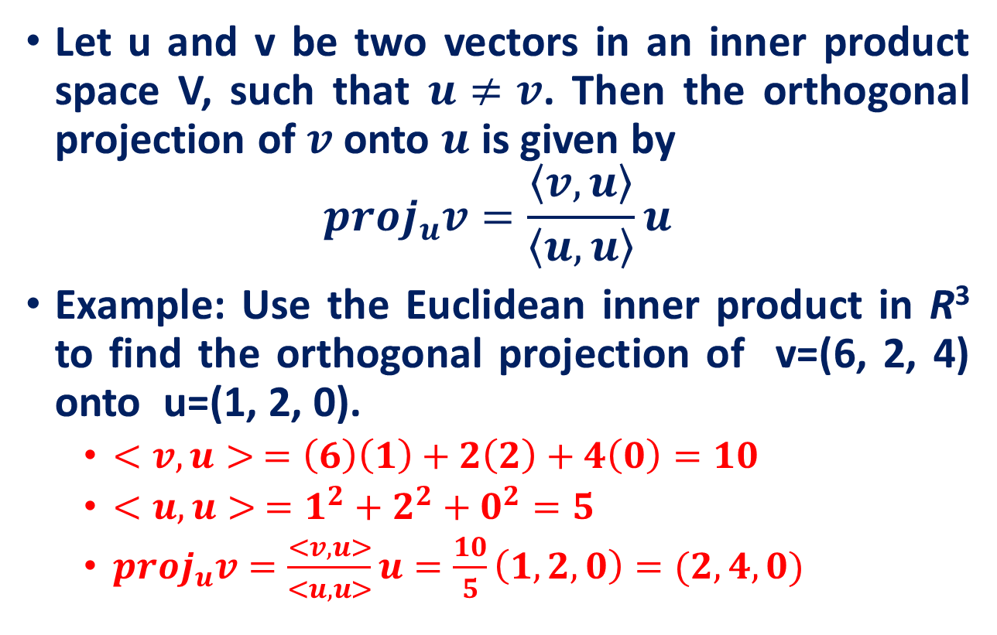
Orthogonal projection
Let u and v be two vectors in an inner product space V, such that $u≠v$. Then the orthogonal projection of $v$ onto $u$ is given by
$$proj_{u}v=\frac{\left\langle v,u\right\rangle }{\left\langle u,u\right\rangle }u$$
Example: Use the Euclidean inner product in R³ to find the orthogonal projection of v=(6, 2, 4) onto u=(1, 2, 0).
$<v,u> =\left(6\right)\left(1\right)+2\left(2\right)+4\left(0\right)=10$
$<u,u> =1^{2}+2^{2}+0^{2}=5$
$proj_{u}v=\frac{<v,u>}{<u,u>}u=\frac{10}{5}\left(1,2,0\right)=(2,4,0)$
v
u

Slide 15

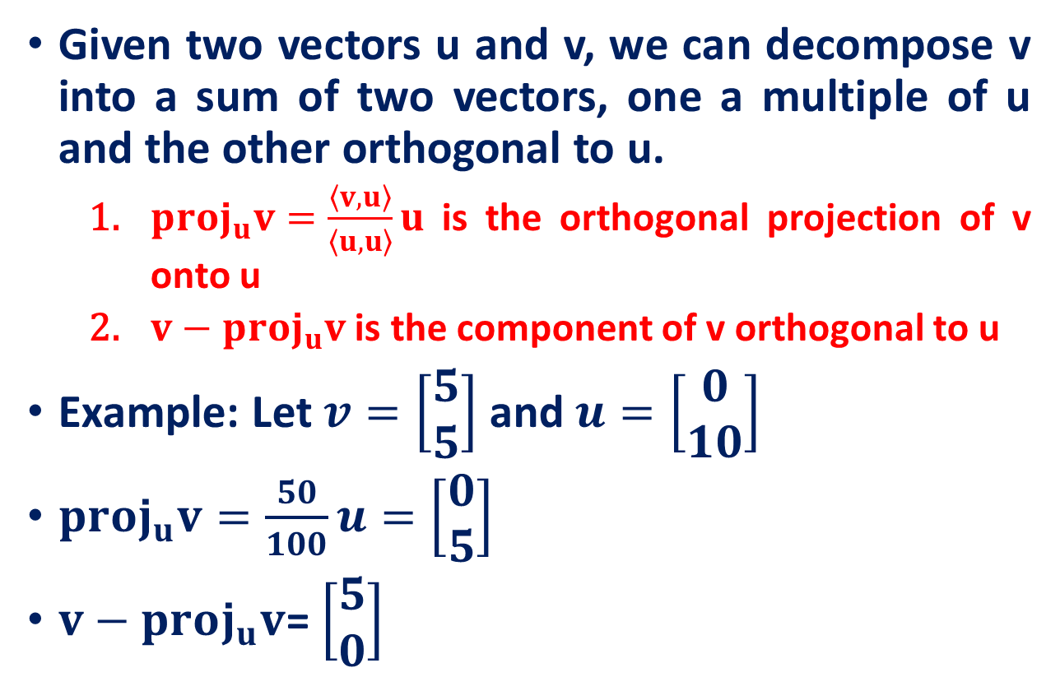



Orthogonal projection
Given two vectors u and v, we can decompose v into a sum of two vectors, one a multiple of u and the other orthogonal to u.
$proj_{u}v=\frac{\left\langle v, u\right\rangle }{\left\langle u, u\right\rangle }u$ is the orthogonal projection of v onto u
$v−proj_{u}v$ is the component of v orthogonal to u
Example: Let $v=\left[\begin{matrix}5 \\ 5\end{matrix}\right]$ and $u=\left[\begin{matrix}0 \\ 10\end{matrix}\right]$
$proj_{u}v=\frac{50}{100}u=\left[\begin{matrix}0 \\ 5\end{matrix}\right]$
$v−proj_{u}v$= $\left[\begin{matrix}5 \\ 0\end{matrix}\right]$
v
u
$$u$$
$$proj_{u}v=\left[\begin{matrix}0 \\ 5\end{matrix}\right]$$
$$v$$
$v−proj_{u}v$= $\left[\begin{matrix}5 \\ 0\end{matrix}\right]$

Slide 16
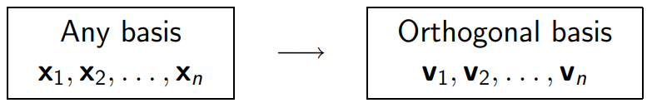
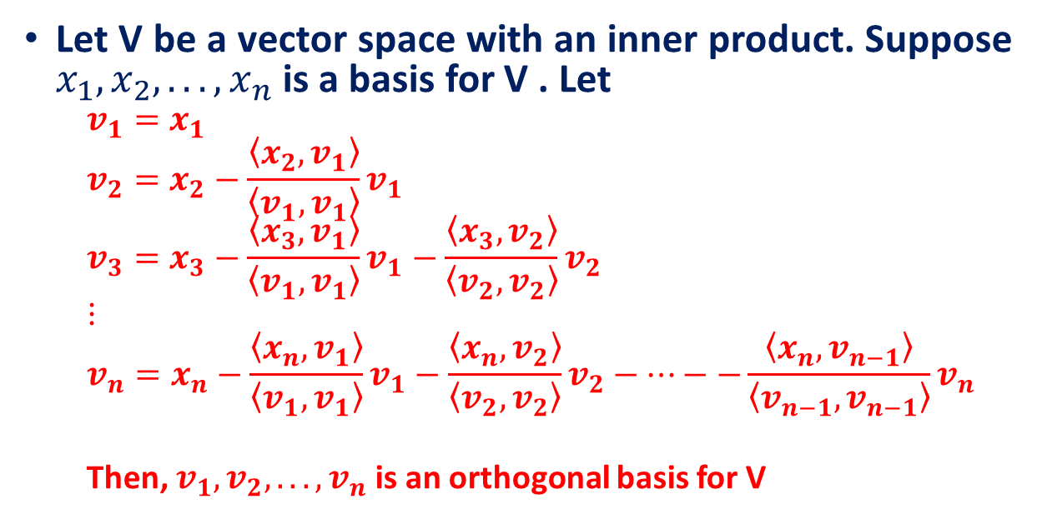
Gram-Schmidt Orthogonalization
Let V be a vector space with an inner product. Suppose $x_{1},x_{2}, . . . ,x_{n}$is a basis for V . Let
$$v_{1}=x_{1}$$
$$v_{2}=x_{2}−\frac{\left\langle x_{2}, v_{1}\right\rangle }{\left\langle v_{1},v_{1}\right\rangle }v_{1}$$
$$v_{3}=x_{3}−\frac{\left\langle x_{3}, v_{1}\right\rangle }{\left\langle v_{1},v_{1}\right\rangle }v_{1}−\frac{\left\langle x_{3}, v_{2}\right\rangle }{\left\langle v_{2},v_{2}\right\rangle }v_{2}$$
$$⋮$$
$$v_{n}=x_{n}−\frac{\left\langle x_{n}, v_{1}\right\rangle }{\left\langle v_{1},v_{1}\right\rangle }v_{1}−\frac{\left\langle x_{n}, v_{2}\right\rangle }{\left\langle v_{2},v_{2}\right\rangle }v_{2}−⋯−−\frac{\left\langle x_{n}, v_{n−1}\right\rangle }{\left\langle v_{n−1},v_{n−1}\right\rangle }v_{n}$$
Then, $v_{1},v_{2}, . . . ,v_{n}$is an orthogonal basis for V

Slide 17
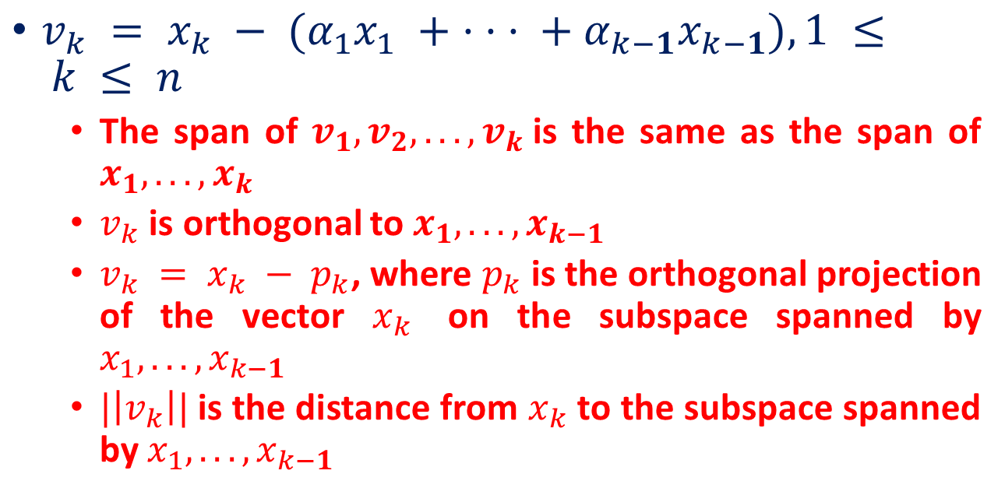
Properties of Gram-Schmidt Process
$v_{k} = x_{k} − (α_{1}x_{1} + · · · + α_{k−1}x_{k−1}), 1 ≤ k ≤ n$
The span of $v_{1},v_{2}, . . . ,v_{k}$is the same as the span of $x_{1}, . . . ,x_{k}$
$v_{k}$ is orthogonal to $x_{1}, . . . ,x_{k−1}$
$v_{k} = x_{k} − p_{k}$, where $p_{k}$ is the orthogonal projection of the vector $x_{k}$ on the subspace spanned by $x_{1}, . . . ,x_{k−1}$
$|\left|v_{k}\right||$is the distance from $x_{k}$ to the subspace spanned by $x_{1}, . . . ,x_{k−1}$

Slide 18
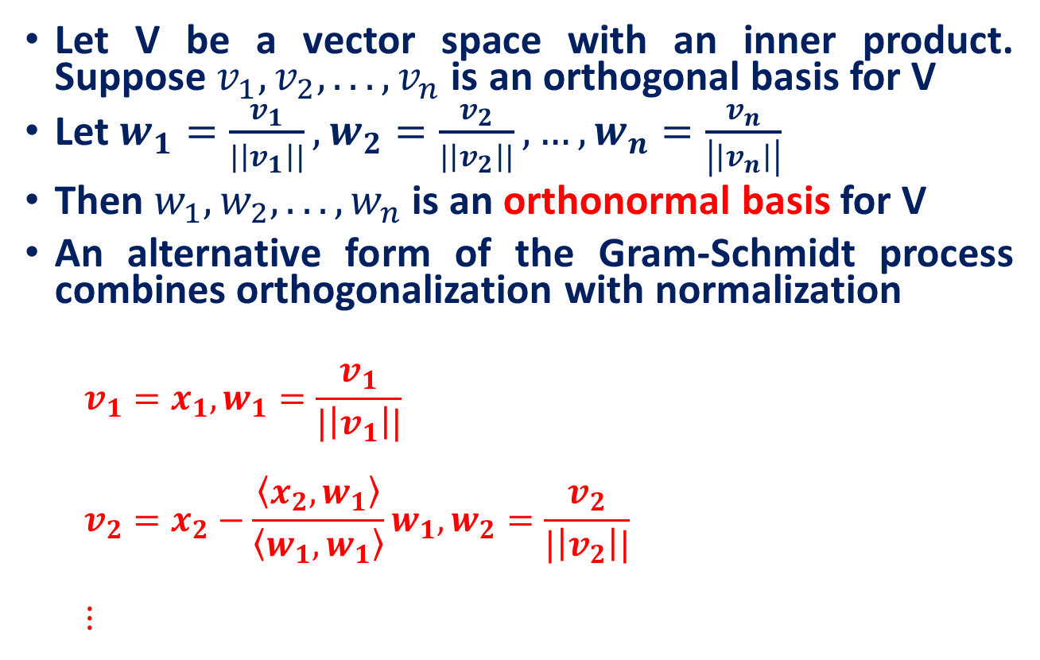
Normalization
Let V be a vector space with an inner product. Suppose $v_{1},v_{2}, . . . ,v_{n}$is an orthogonal basis for V
Let $w_{1}=\frac{v_{1}}{|\left|v_{1}\right||},w_{2}=\frac{v_{2}}{|\left|v_{2}\right||},…,w_{n}=\frac{v_{n}}{\left|\left|v_{n}\right|\right|}$
Then $w_{1},w_{2}, . . . ,w_{n}$is an orthonormal basis for V
An alternative form of the Gram-Schmidt process combines orthogonalization with normalization
$$v_{1}=x_{1},w_{1}=\frac{v_{1}}{|\left|v_{1}\right||}$$
$$v_{2}=x_{2}−\frac{\left\langle x_{2}, w_{1}\right\rangle }{\left\langle w_{1},w_{1}\right\rangle }w_{1},w_{2}=\frac{v_{2}}{|\left|v_{2}\right||}$$
$$⋮$$

Slide 19
Example: Gram-Schmidt Orthogonalization
Apply the Gram-Schmidt process to the following basis.
Sol:
Source: Lecture 12, Inner Product Space & Linear Transformation

Slide 20
Example: Gram-Schmidt Orthogonalization
Orthonormal basis

Slide 21
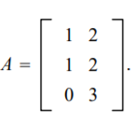
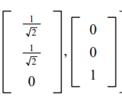

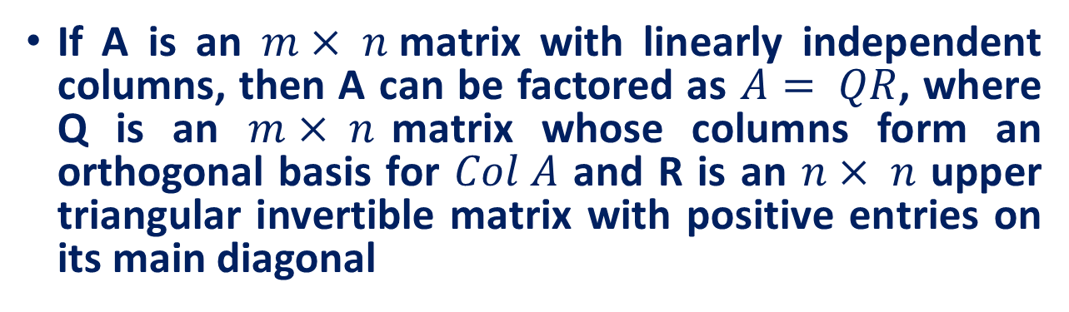
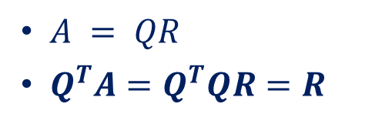
The QR Factorization: Basic Idea
If A is an $m× n$matrix with linearly independent columns, then A can be factored as $A= QR$, where Q is an $m× n$matrix whose columns form an orthogonal basis for $Col A$ and R is an $n× n$ upper triangular invertible matrix with positive entries on its main diagonal
Applications
linear equations
least squares problems
constrained least squares problems
Using the Gram Schmidt process, we can find orthonormal basis for col A
Q =
$A = QR$
$Q^{T}A=Q^{T}QR=R$
Source: http://www2.math.uconn.edu/~troby/math2210f16/LT/sec6_4.pdf

Slide 22
Topics for the next class
Linear Mappings
Kernel and Image space of a linear map
Matrix associated with linear map
Eigenvectors & Eigenvalues

Slide 23
Reference
Introduction to Linear Algebra, Mark Goldman, Emily Mackevicius
Lecture Notes on Linear Algebra, Arbind K Lal, Sukant Pati
Lecture notes on linear algebra, David Lerner
6502 : Mathematics for Engineers 2, James Burnett, Department of Mathematics, University College London
ENGG2013, Advanced Engineering Math. Kenneth Shum
Matrices and Determinants – 2, Carrer launcher
http://www.shsu.edu/ldg005/data/mth199/chapter5.ppt
Lecture 12, Inner Product Space & Linear Transformation

